Slide 1
"Always code as if the guy who ends up maintaining your code will be a violent psychopath who knows where you live."
John woods.

Slide 2

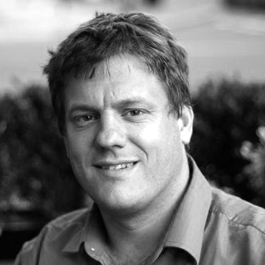
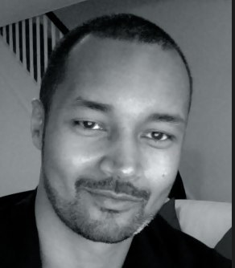
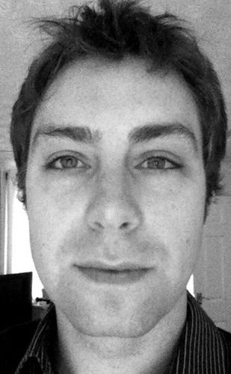
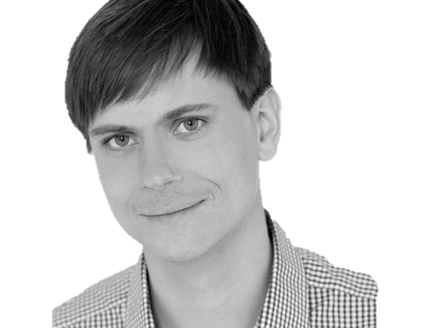

@riverglide
@andypalmer
@antonymarcano
@jmrtn
@pro_cessor

Slide 3

Ψ

Slide 4
Informatik
Keine Naturwissenschaft

Slide 5
Einstellungsähnlichkeit korreliert positiv mit DER interpersonellen Anziehung

Slide 6
Gleich und Gleich Einstellungsähnlichkeit korreliert positiv mit DER interpersonellen Anziehung gesellt sich gern

Slide 7
Die gravitationsbedingte vertikale Dislokation maliformer Agrarprodukte aus der Position ihrer Bio-Genese erfolgt in der Regel proxitrunkial

Slide 8

Der APFEL Fällt nicht Die gravitationsbedingte vertikale Dislokation maliformer Agrarprodukte aus der Position ihrer Bio-Genese erfolgt in der Regel proxitrunkial weit vom stamm

Slide 9
M a s c h i n e
Wir schreiben für die
anstatt für uns.

Slide 10
S
Open – Closed Principle
Liskov Substitution Principle
Interface Segregation Principle
Dependency Inversion Principle

Slide 11
S
O
Liskov Substitution Principle
Interface Segregation Principle
Dependency Inversion Principle

Slide 12
S
O
L
Interface Segregation Principle
Dependency Inversion Principle

Slide 13
S
O
L
I
Dependency Inversion Principle

Slide 14
S
O
L
I
D

Slide 15
S
O
L
I
D

Slide 16
S
O
L
I
D
Release-Reuse Equivalency Principle
Common Reuse Principle
Common Closure Principle
Acyclic Dependency Principle
Stable Abstractions Principle
Stable Dependencies Principle

Slide 17
S
O
L
I
D
RR
Common Reuse Principle
Common Closure Principle
Acyclic Dependency Principle
Stable Abstractions Principle
Stable Dependencies Principle

Slide 18
S
O
L
I
D
RR
CR
Common Closure Principle
Acyclic Dependency Principle
Stable Abstractions Principle
Stable Dependencies Principle

Slide 19
S
O
L
I
D
RR
CR
CC
Acyclic Dependency Principle
Stable Abstractions Principle
Stable Dependencies Principle

Slide 20
S
O
L
I
D
RR
CR
CC
AD
Stable Abstractions Principle
Stable Dependencies Principle

Slide 21
S
O
L
I
D
RR
CR
CC
AD
SA
Stable Dependencies Principle

Slide 22
S
O
L
I
D
RR
CR
CC
AD
SA
SD

Slide 23
S
O
L
I
D
RR
CR
CC
AD
SA
SD
Tell, don‘t ask
DRY
KISS
YAGNI

Slide 24
S
O
L
I
D
RR
CR
CC
AD
SA
SD
Tell, don‘t ask
DRY
KISS
YAGNI

Slide 25
S
O
L
I
D
RR
CR
CC
AD
SA
SD
Tell, don‘t ask
DRY
KISS
YAGNI

Slide 26
S
O
L
I
D
RR
CR
CC
AD
SA
SD
Tell, don‘t ask
DRY
KISS
YAGNI

Slide 27
S
O
L
I
D
RR
CR
CC
AD
SA
SD
Tell, don‘t ask
DRY
KISS
YAGNI

Slide 28
Separation
Machine
Domain
??

Slide 29
MACHINE
INTENT

Slide 30
Empathie
Von Person zu Person

Slide 31
Empathy is the capacity to think and feel oneself into the inner life of another person
Heinz Kohut Psychoanalyst

Slide 32
Emotions
Boundaries
Language

Slide 33
Simple First
Paradigm-Commitment
Abstraction Segregation
Domain Relationship
Listening and Learning
Languages
Binary Dependency
Domain Language
Shared Under-standing
Eloquence
Patterns aren’t solutions
Weasel Word Removal

Slide 34
Simple First
Paradigm-Commitment
Abstraction Segregation
Domain Relationship
Listening and Learning
Languages
Binary Dependency
Domain Language
Shared Under-standing
Eloquence
Patterns aren’t solutions
Weasel Word Removal

Slide 35
Erst mal einfach
Simple First!
Richtig schwer!

Slide 36
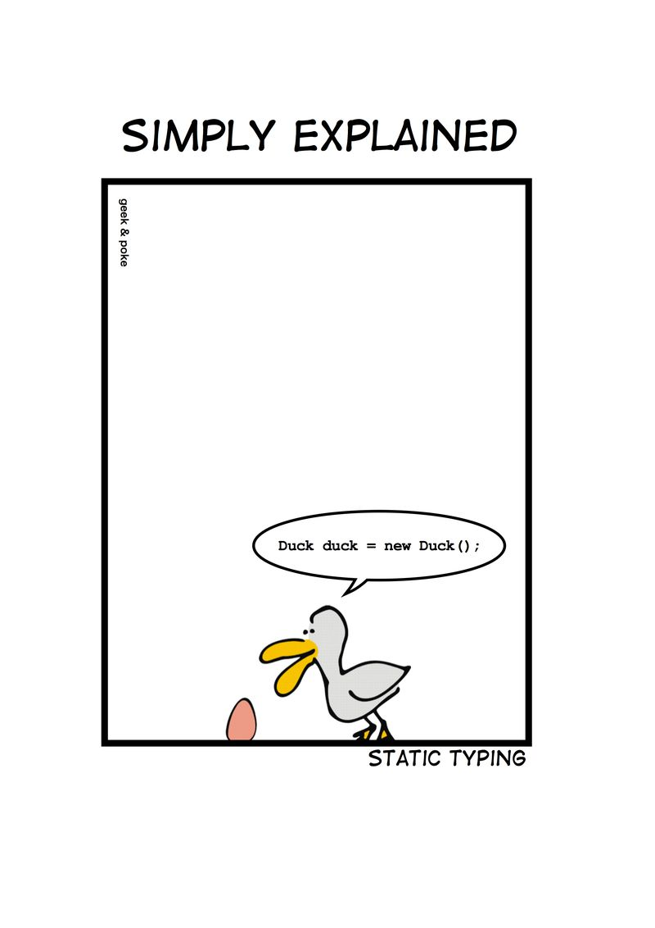
Notes:
Wie entscheidet man, ob etwas einfach ist?

Slide 37
C# Duck duck = new Duck();

Slide 38
Python duck = Duck()

Slide 39
C# - DRY var duck = new Duck();

Slide 40
Zug.un.glück
Es steht ein
bevor

Slide 41
Don’t ASK
Tell.
Or: The Law of Demeter

Slide 42
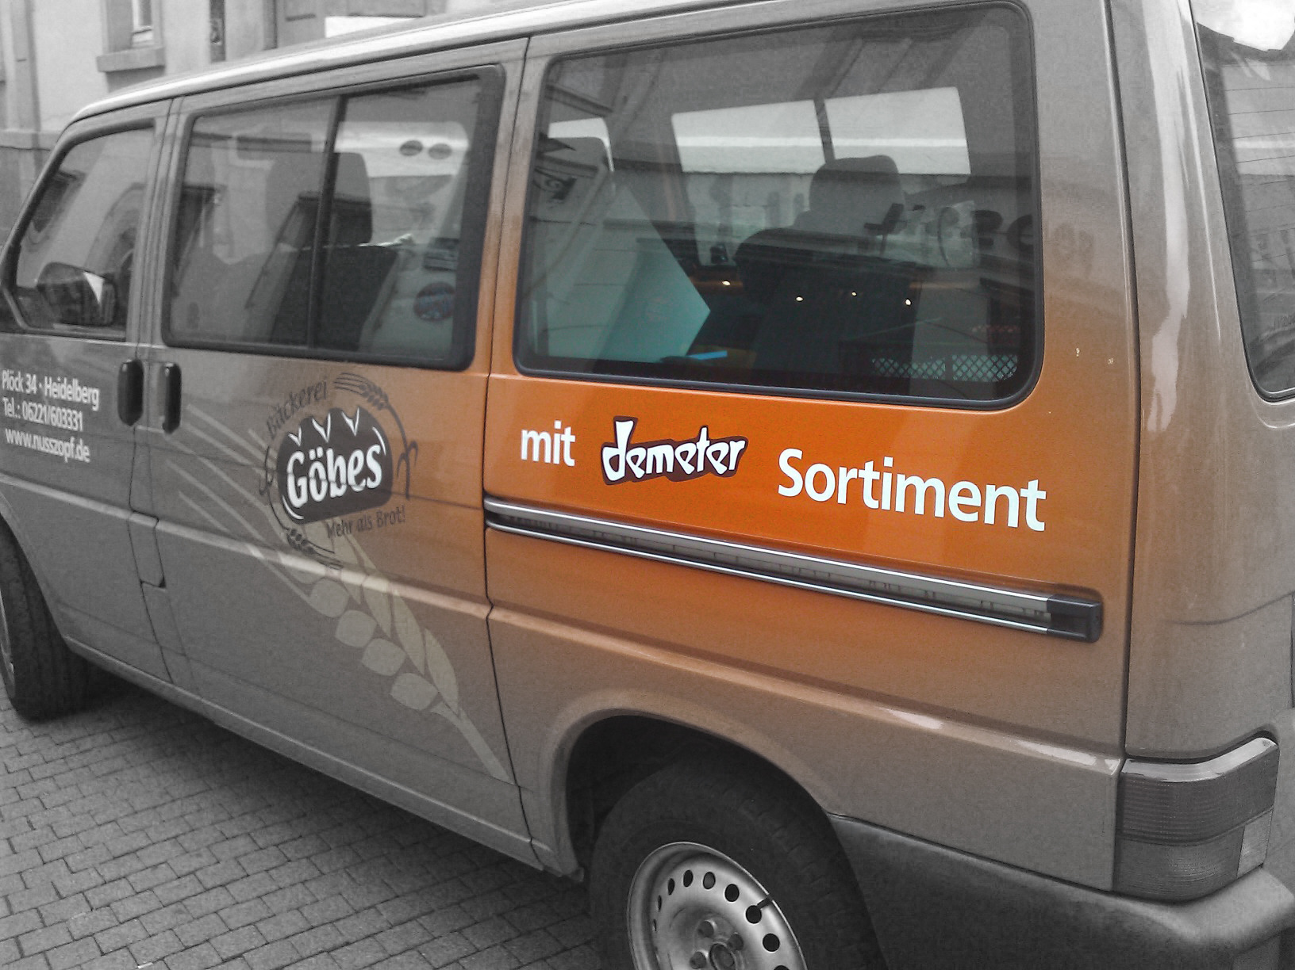

Slide 43
if(Customer.Email.Address.Value.IsValid) { Send(Customer.Email.Address, message); }

Slide 44
if(Customer.IsEmailValid()) { Send(Customer.Email.Address, message); }

Slide 45
Customer.Send(message)

Slide 46
Message.SendTo(Customer)

Slide 47
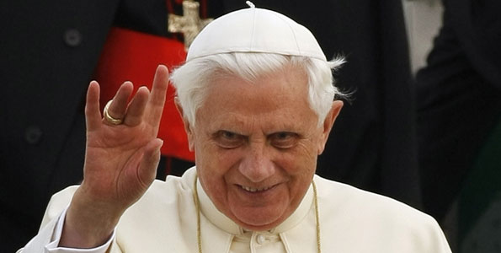
Don’t let a stranger touch your privates

Slide 48
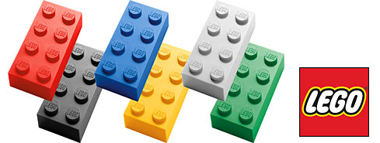
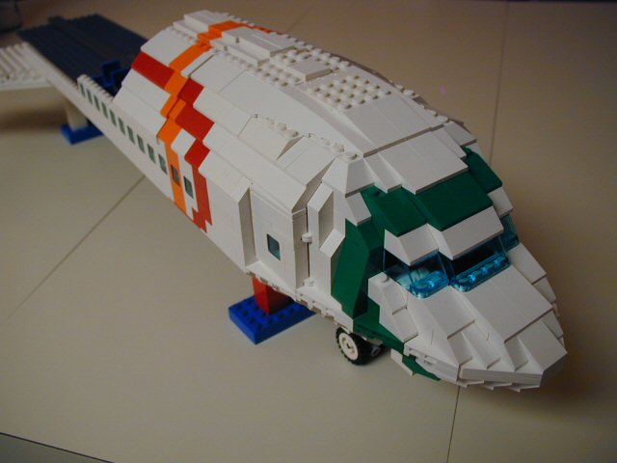
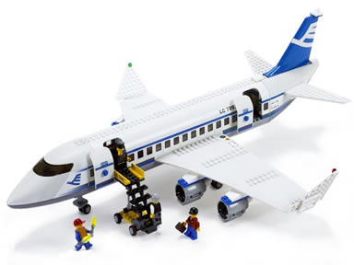
Size & Reuse

Slide 49
überraschungen
Keine
Was erwartest du?

Slide 50
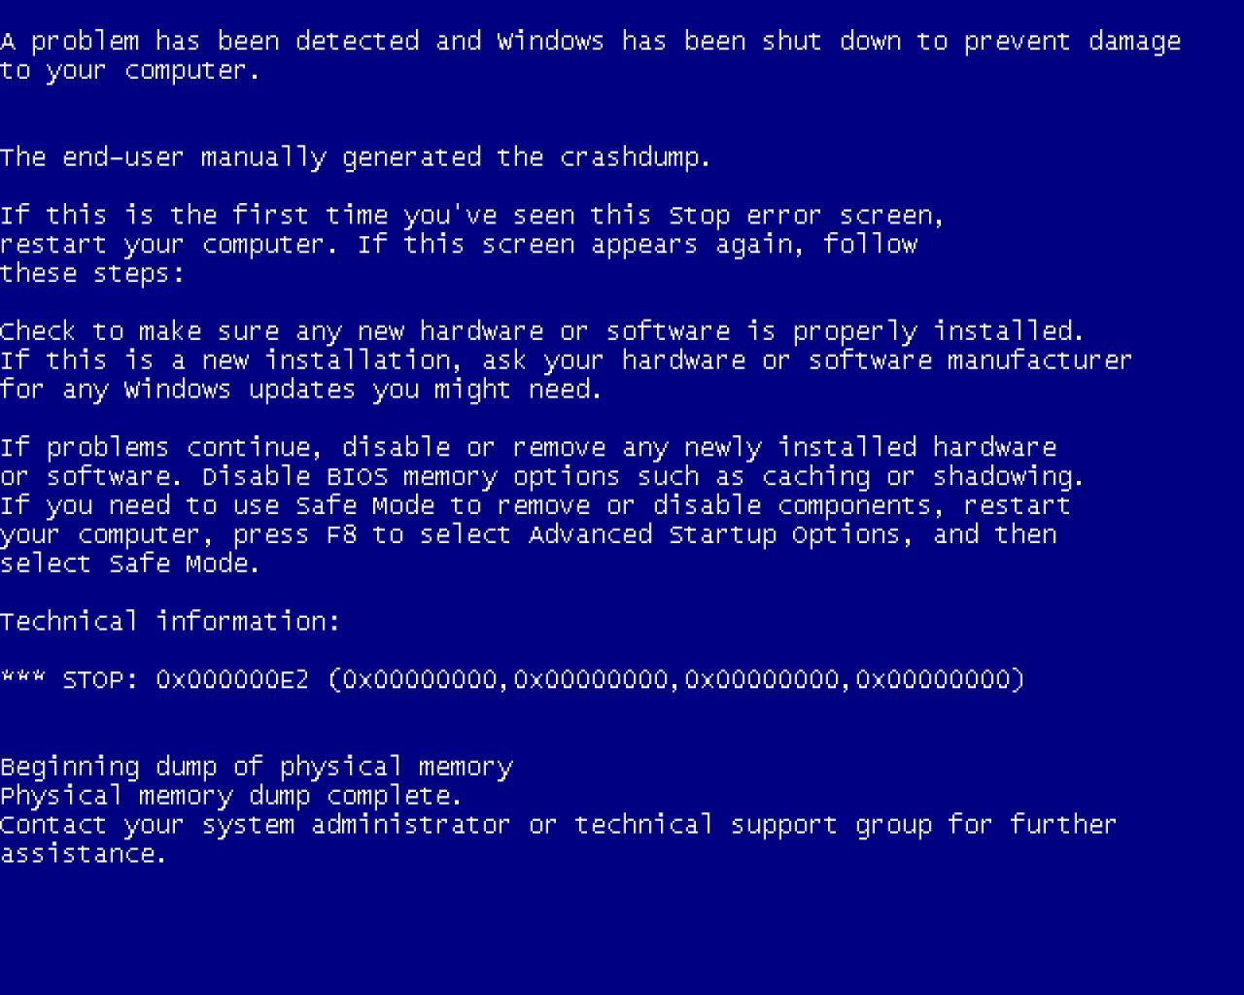
Notes:
Diese Folie ist ein Nullobjekt

Slide 51
Notes:
Diese Folie ist ein Nullobjekt

Slide 52
NullObjekte

Slide 53
Spüre deinen Code
Man sieht nur mit dem Herzen gut

Slide 54
public void Execute(MainViewModel mainViewModel) { mainViewModel.Done = () => Break(mainViewModel); mainViewModel.StartCounter(); } public void Break(MainViewModel model) { model.Color = 0x00DBFF.Rgb().Brush(); model.TimeLeft = 5.Minutes(); model.Done = () => Work(model); model.StartCounter(); } public void Work(MainViewModel model) { model.Color = 0x00DB00.Rgb().Brush(); model.TimeLeft = 25.Minutes(); model.Done = () => Break(model); model.StartCounter(); }

Slide 55
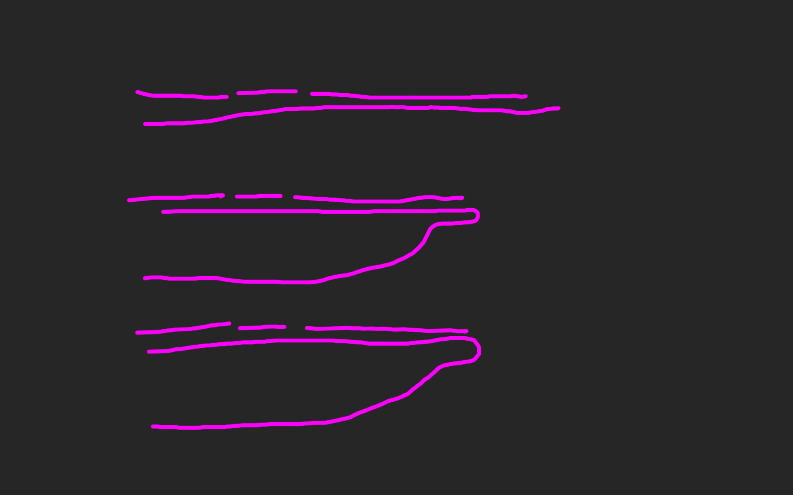
public void Execute(MainViewModel mainViewModel) { mainViewModel.Done = () => Break(mainViewModel); mainViewModel.StartCounter(); } public void Break(MainViewModel model) { model.Color = 0x00DBFF.Rgb().Brush(); model.TimeLeft = 5.Minutes(); model.Done = () => Work(model); model.StartCounter(); } public void Work(MainViewModel model) { model.Color = 0x00DB00.Rgb().Brush(); model.TimeLeft = 25.Minutes(); model.Done = () => Break(model); model.StartCounter(); }

Slide 60
def filter(markup): return add_twitter_names(markup) def add_twitter_names(markup): pattern = "@(\w+)" url = "https://twitter.com/" link = "<a href='%s\\1'>@\\1</a>" % url replacement = link return re.sub(pattern, replacement, markup) def home(entries): markup = create_page(entries) markup = filter(markup) return markup def main(): entries = Entries() if len(argv) > 1: date = argv[1] entries = entries.written_on(date) print home(entries)

Slide 61
GESUNDHEIT
Die einfachste Metrik
für die C-Familie

Slide 62
Signature Survey Datei (<loc>): { ; }

Slide 63
ExitWindowsFlags.cs (17): ;{{}} FullScreen.cs (10): {{{;}}} HexToColorExtension.cs (30): ;{{{;}{;}{;}}} Hibernate.cs (23): ;{{{}{}{;;;;}}} ICanBeSelected.cs (10): ;;{{;}} ICanStartAndStop.cs (12): ;{{{;;};;}} IExecute.cs (10): ;;{{;}} IHaveGotTheTime.cs (9): ;{{{;}}} IntToTimespanExtension.cs (26): ;{{{;}{;}{;}}} InvisibilityConverter.cs (20): ;;;;{{{;}{;}}} IShutdownTheSystem.cs (7): {{;}} IWindowsFunctions.cs (9): {{;;;}} KeyExtension.cs (17): ;{{{;}{;}}} Lock.cs (20): ;{{{}{}{;}}} LogOff.cs (21): ;{{{}{}{;;}}} MainViewModel.cs (103): ;;;;;;{{;;;;;;;;;{;;;}{{;}{;}}{{;}{;}}{{;}{;}}{{;}{;}}{;;;;;}{;;}{;}{;{;;}}{;}{;;}{;;;;}}} MainWindow.xaml.cs (42): ;;;;;{{;{;;;}{{;}}{;;;}{;;}}} MenuItemExtension.cs (17): ;;;{{{{;}}}} MouseWheelGesture.cs (56): ;{{{}{}{;;}{{{};}}{{{};}}{{{};}}{{{};}}{;;;{;;;;}}}} MutuallyExclusiveCheckBoxes.cs (42): ;;{{{;}{;}{;;;;}{;}{;}{;}}} PlaySound.cs (23): ;;;;;{{{{;}{;}}}} PomodoroTimer.cs (33): ;;;{{{;;}{;;;;}{;;;;}}} RegisterShutdownEvent.cs (12): ;{{{;}}} RegisterTimeoutEvent.cs (23): ;{{{;;}{;}{;}}} ResetTimer.cs (21): ;;;{{;{;}{;}}} Restart.cs (21): ;{{{}{}{;;}}} RestartTimer.cs (21): ;;{{;{;}{;;}}} SetColor.cs (37): ;{{;{;;;;;;}{;;}}} SetTime.cs (18): ;;{{{;}{;}}} Shutdown.cs (21): ;{{{}{}{;;}}} ShutdownReason.cs (47): ;{{}} Sleep.cs (23): ;{{{}{}{;;;;}}} Start.cs (10): {{{;}}} Stop.cs (10): {{{;}}} TimeSpanExtensions.cs (12): ;{{{;}}} Toggle.cs (13): ;{{{;;}}} ViewCommand.cs (15): ;;{{{;;}{;}}} ViewModel.cs (39): ;;;{{{;;}{{};}{{};;;}}} ViewModelBaseWeasel.cs (29): ;;{{;{;;;}{;;;}}} VisibilityConverter.cs (20): ;;;;{{{;}{;}}} Wheel.xaml.cs (20): ;;;{{{;}{;;}}} WheelDirection.cs (9): {{}}

Slide 64
LogOff.cs (21): ;{{{}{}{;;}}} MainViewModel.cs (103): ;;;;;;{{;;;;;;;;;{;;;}{{;}{;}}{{;}{;}}{{;}{;}} MainWindow.xaml.cs (42): ;;;;;{{;{;;;}{{;}}{;;;}{;;}}} MenuItemExtension.cs (17): ;;;{{{{;}}}} MouseWheelGesture.cs (56): ;{{{}{}{;;}{{{};}}{{{};}}{{{};}}{{{};}}{;;;{ MutuallyExclusiveCheckBoxes.cs (42): ;;{{{;}{;}{;;;;}{;}{;}{;}}}

Slide 65
philosophie
Code
Und Maximen

Slide 66
>>> import this

Slide 67
If the implementation is hard to explain, it's a bad idea.
python

Slide 68
Zuhören
Richtig
und dabei lernen!

Slide 69
Wir brauchen einen Automocker.

Slide 70
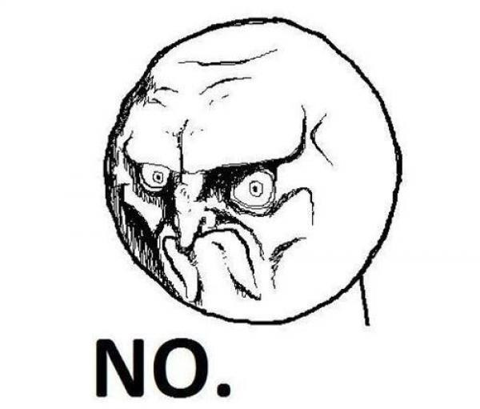

Slide 71
Diese klasse ist schwer zu testen.

Slide 73
Das gleiche sagen
Shared Understanding
vom selben Elephanten

Slide 74
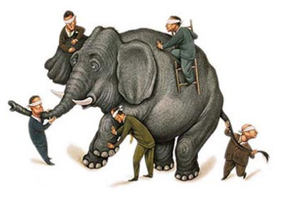

Slide 75
Simple First
Paradigm-Commitment
Abstraction Segregation
Domain Relationship
Listening and Learning
Languages
Binary Dependency
Domain Language
Shared Under-standing
Eloquence
Patterns aren’t solutions
Weasel Word Removal

Slide 76
IM PARADIGMA BLEIBEN
Unabhängig von der Sprache
Und es verstehen

Slide 77
Objekte Funktionen

Slide 78
Relationen Dokumente

Slide 79
Sprachen
Polyglott
C#, F#, Prolog, Io, Haskell, Brainfuck, Python, Ruby, Javascript, Lisp, Smalltalk, C++, C, Java, Groovy, Scala, Clojure, Perl, R

Slide 80
https://github.com/cessor/refuctoring

Slide 81
private static TimeSpan Transform(this IEnumerable<int> digits) { int result = 0; var r = digits.ToList(); for (int j = 0; j < r.Count; j++) { int i = (int)Math.Pow(60, j / 2); int rTimesI = r[r.Count - j - 1] * i; result += (j % 2 == 1) ? rTimesI * 10 : rTimesI; } return TimeSpan.FromSeconds(result); }

Slide 82
private static TimeSpan Transform(this IEnumerable<int> digits) { var secondsPerUnit = new [] { 1,10,60,600,3600,36000 }; return digits .Reverse() .Zip(secondsPerUnit, (digit, unit) => digit * unit) .Sum() .Seconds(); }

Slide 83
“You can call it beautiful code when the code also makes it look like the language was made for the problem”
Ward cunningham.

Slide 84
public class Quicksort { public static int[] Sort(int[] array) { int[] a = new int[array.Length]; array.CopyTo(a, 0); Sort(0, array.Length - 1, ref a); return a; } private static void Sort(int links, int rechts, ref int[] daten) { if (links >= rechts) return; int teiler = Divide(links, rechts, ref daten); Sort(links, teiler - 1, ref daten); Sort(teiler + 1, rechts, ref daten); } private static int Divide(int left, int right, ref int[] data) { int leftpos = left; int rightpos = right - 1; int pivot = data[right]; do { while (data[leftpos] <= pivot && leftpos < right) leftpos++; while (data[rightpos] >= pivot && rightpos > left) rightpos--; if (leftpos >= rightpos) continue; Swap(leftpos, rightpos, ref data); } while (leftpos < rightpos); if (data[leftpos] > pivot) { Swap(leftpos, right, ref data); } return leftpos; } private static void Swap(int left, int right, ref int[] data) { int z = data[left]; data[left] = data[right]; data[right] = z; } }

Slide 85
let rec quicksort (list:int list) = match list with | [] -> [] | head::tail -> let smaller,larger = List.partition (fun y -> y <= head) tail quicksort smaller @ [head] @ quicksort larger

Slide 86
“Clean code reads like well-written prose”
Grady Booch

Slide 87
Natürliche
Gesprochene,
Sprache

Slide 88
var date = new DateTime (2012, 4, 14, 16, 32, 18, 500);

Slide 89
var start = 14.April(2012).At(8.PM()); var end = 8.Hours().Later(start);

Slide 90
for(int i = 0; i < 10; i++) { doSomething(); }

Slide 91
10.times( doSomething );

Slide 92
Sprachfertigkeit
Eloquenz
Eine Sprache richtig sprechen

Slide 93
Wenn du mir erklären kannst, was da passiert, wieso steht das da dann nicht?

Slide 94
[Test] public void ShouldConvertAnEvenNumberOfDigitsToATimespan() { // Arrange var bytes = new byte[] { 0, 0, 1,5, 0,5 }; var expected = new TimeSpan(0, 0, 15, 5, 0); // Act var actual = Transform(bytes); // Assert actual.Should().Equal(expected); }

Slide 95
When.IType(1, 5, 0, 5).And() .TransformTheDigits() .Then().TheResult().Should().Equal( 15.Minutes().And(5.Seconds()) );

Slide 96
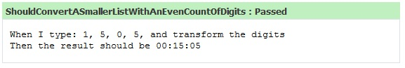

Slide 97
Simple First
Paradigm-Commitment
Abstraction Segregation
Domain Relationship
Listening and Learning
Languages
Binary Dependency
Domain Language
Shared Under-standing
Eloquence
Patterns aren’t solutions
Weasel Word Removal

Slide 98
Abstraktion
Trennen von Einzelheiten
in Domäne und Maschine

Slide 99
for int i=0; GetCustomer

Slide 100
Exceptionell,
Ist etwas
Wenn du es erwartest?

Slide 101
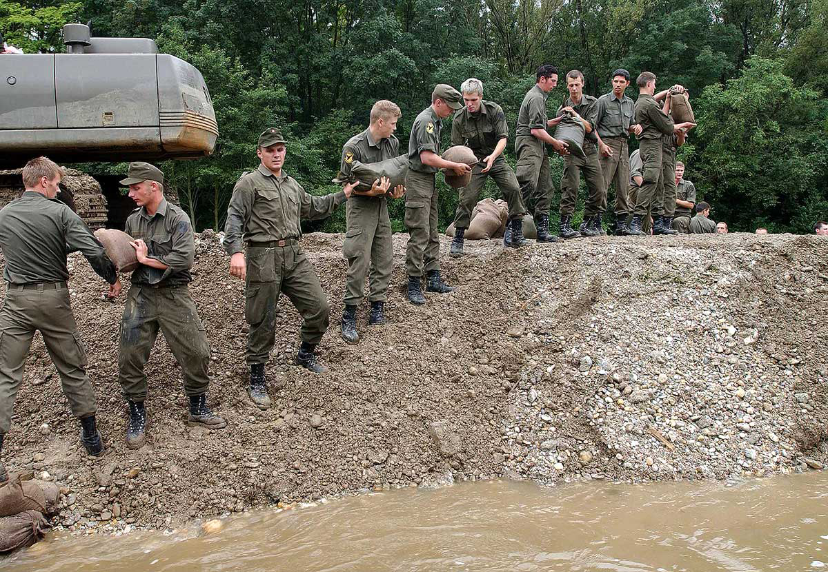

Slide 102
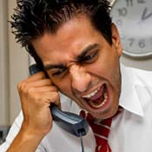
Complaints
Beschwerden
Wenn ein Problem besteht

Slide 103
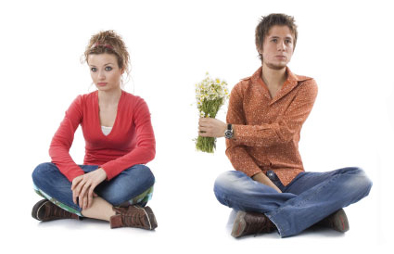
Apologies
Entschuldigung
Wenn es verzeihbar ist

Slide 104
Binäre Abhängigkeit
x = 1 + 2
Meist reicht das.

Slide 105
Dependent-on Components
Interactions
DATA

Slide 106
Event Based Components
EBC
Pins
Board

Slide 107
Imports Parameter Binäre Bäume

Slide 108
Entwurfsmuster
Design Patterns
Sind keine Lösung

Slide 109
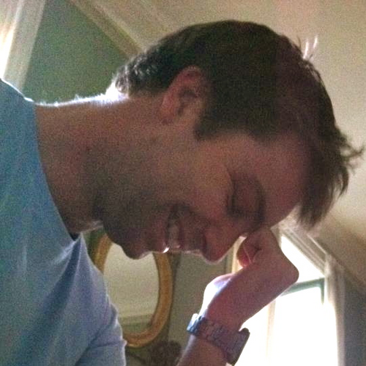
https://twitter.com/#!/jmrtn http://jmrtn.com/notes/2012/02/17/design-patterns.html

Slide 110
Simple First
Paradigm-Commitment
Abstraction Segregation
Domain Relationship
Listening and Learning
Languages
Binary Dependency
Domain Language
Shared Under-standing
Eloquence
Patterns aren’t solutions
Weasel Word Removal

Slide 111
DomänenBEZUG
Wenn du darüber sprichst…
…ist es wahrscheinlich wichtig

Slide 112
War stories
Also ich hab da…

Slide 113
“Also ich hab da so ne Software”

Slide 114
“Also ich hab da so ne Software, die bearbeitet so Bilder.”

Slide 115
“Also ich hab da so ne Software, die bearbeitet so Bilder. Aber ich hab da so zwei viel zu große Klassen.”

Slide 116
“Also ich hab da so ne Software, die bearbeitet so Bilder. Aber ich hab da viel zu große Klassen. Und ich reiche da so ein Bytearray rum.”

Slide 117
“Also ich hab da so ne Software, die bearbeitet so Bilder. Aber ich hab da viel zu große Klassen. Und ich reiche da so ein Bytearray rum. Und das wird dann von allen bearbeitet.”

Slide 118
“Also ich hab da so ne Software, die bearbeitet so Bilder. Aber ich hab da viel zu große Klassen. Und ich reiche da so ein Bytearray rum. Und das wird dann von allen bearbeitet. Das ist schon ziemlich kompliziert…”

Slide 120
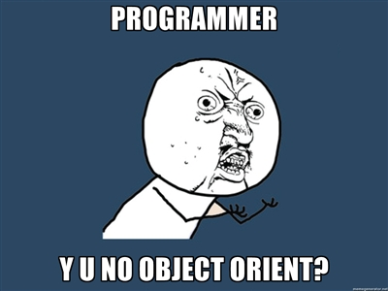

Slide 121
Bilder sind keine ByteArrays

Slide 122
Email Adressen sind keine Strings

Slide 123
TinY TYpes

Slide 124
Dinge müssen nicht können aber sie können sein

Slide 125
Email InvalidEmail

Slide 126
Polymorphismen Typen

Slide 127
Domänensprache
Ubiquitous Language
Gegen Babylonische Sprachverwirrung

Slide 128
Systemische Metapher Klare Namen

Slide 129
Simple First
Paradigm-Commitment
Abstraction Segregation
Domain Relationship
Listening and Learning
Languages
Binary Dependency
Domain Language
Shared Under-standing
Eloquence
Patterns aren’t solutions
Weasel Word Removal

Slide 130
"Always code as if the guy who ends up maintaining your code will be a violent psychopath who knows where you live."
John Woods.

Slide 131
@riverglide
@andypalmer
@antonymarcano
@jmrtn
@pro_cessor

Slide 132
Ψ

Slide 133
Managerbrokerdispatcher interfaceimpl

Slide 134
http://www.classnamer.com/

Slide 135
CheckedGraphContext StatelesErrorCorrectingMessageGeneratorsRecordGenerator

Slide 136
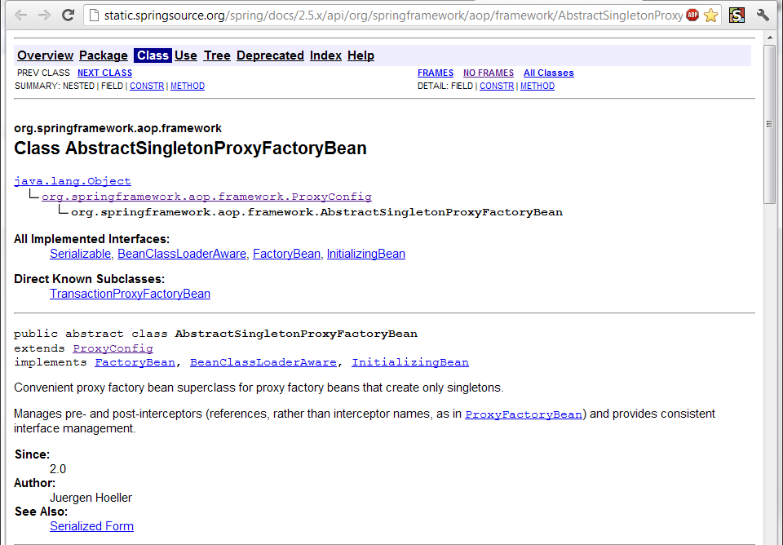

Slide 137
Class AbstractSingletonProxyFactoryBean Convenient proxy factory bean superclass for proxy factory beans that create only singletons.

Slide 138
Clean code *
*The book!

Slide 139
intentionrevealing
Use
Names
ABSICHTSVERMITTELNDE

Slide 140
DEsinformation
Vermeide

Slide 141
aussagekräftige
Erzeuge
Unterschiede

Slide 142
Suchbare
Verwende
Namen

Slide 143
aussprechbare
Verwende
Namen

Slide 144
genymdhms

Slide 145
private Date genymdhms

Slide 146
private Date generationTimestamp

Slide 147
/// <summary> /// Gets or sets. /// Used for Ewiomc. /// </summary> /// <remarks> /// Used internally by the bl. /// </remarks> public string Vdewgvgwid { get; set; } WTF? Ich geh heim.

Slide 148
Klassennamen
Aussage
kräftig

Slide 149
“Classes and objects should have noun or noun phrase names like customer, WikiPage, Account, and Addressparser. Avoid words like manager, Processor,, Data, or Info in the Name of a class. A class Name should not be a verb.”

Slide 150
“Classes and objects should have noun or noun phrase names like customer, WikiPage, Account, and Addressparser. Avoid words like manager, Processor,, Data, or Info in the Name of a class. A class Name should not be a verb.”

Slide 151
“Classes and objects should have noun or noun phrase names like customer, WikiPage, Account, and Addressparser. Avoid words like manager, Processor,, Data, or Info in the Name of a class. A class Name should not be a verb.”

Slide 152
“Classes and objects should have noun or noun phrase names like customer, WikiPage, Account, and Addressparser. Avoid words like manager, Processor,, Data, or Info in the Name of a class. A class Name should not be a verb.”

Slide 153
“Classes and objects should have noun or noun phrase names like customer, WikiPage, Account, and Addressparser. Avoid words like manager, Processor, Data, or Info in the Name of a class. A class Name should not be a verb.”

Slide 154
WAR
UM?

Slide 160
?

Slide 166
CONtext

Slide 167
I3

Slide 168
A I3 C

Slide 169
I3
I2
I4

Slide 170
A I3 C
A I2 C
A I4 C

Slide 171
CONtext
Bilden sie mal einen Satz mit…
Notes:
Klappt das auch mit Worten? Oder nur visuell?

Slide 172
Ich weiß nicht was soll Espe deuten, Dass ich so traurig bin; Eimerchen aus uralten Zeiten, Das kommt mir nicht aus dem Sinn.
Schiller, Loreley, 1837

Slide 173
Ich weiß nicht was soll Espe deuten, Dass ich so traurig bin; Eimerchen aus uralten Zeiten, Das kommt mir nicht aus dem Sinn.
Heinrich Heine, Loreley, 1824

Slide 174
The Box

Slide 175
The Box
Think here!

Slide 176
Deinen feind
Kenne
Und respektiere ihn.

Slide 177
Weasel Words

Slide 178
“I can suck melancholy out of a song, as a weazel sucks eggs.”
Shakespeare, as you like it, ii. 5..

Slide 179
Taxonomie
Klassifikation
Ordnung

Slide 180
Hungarian
Party Hats
Philo
sophers

Slide 181
Double int long string

Slide 182
pWindow cCustomers

Slide 183
[DllImport("user32.dll")] static extern bool CloseWindow(IntPtr hWnd);

Slide 184
[DllImport("user32.dll", SetLastError=true)] static extern IntPtr CreateWindowEx( WindowStylesEx dwExStyle, string lpClassName, string lpWindowName, WindowStyles dwStyle, int x, int y, int nWidth, int nHeight, IntPtr hWndParent, IntPtr hMenu, IntPtr hInstance, IntPtr lpParam);

Slide 185
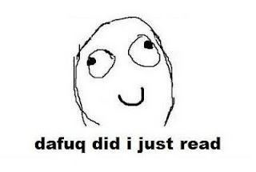

Slide 186
public int SumIntegersUpTo(int bound) { return Enumerable.Range(1, bound).Sum(); }

Slide 187
private readonly ICanStartAndStop _counter; private readonly Wristwatch _wristwatch; private Brush _color; private double _fontSize; private bool _isRunning = false; private TimeSpan _timeLeft;

Slide 188
Hungarian
Party Hats
Philo
sophers

Slide 189
for(int i = 0; i < customers.Count; i++) { Customer theCustomer = customers[i]; ... }

Slide 190
foreach(var customer in customers) { ... }

Slide 191
MehrfachEn
Hilfsmittel zur
Vergabe des selben Namens

Slide 192
my

Slide 193
THE

Slide 194
AN

Slide 195
IT

Slide 196
Hungarian
Party Hats
Philo
sophers

Slide 197
Data Info

Slide 198
Function Process

Slide 199
System Model

Slide 200
Vanity
Details

Slide 201
IMPORTANCE
Eitle Wichtigtuer
Aufgeblasen!

Slide 202
Flexible General

Slide 203
Extended Super

Slide 204
ABSTRACT

Slide 205
public abstract class AbstractTopLevelItem extends AbstractItem implements TopLevelItem { // ... }

Slide 206
Simplicity
Die Schönheit liegt
im Auge des Betrachters

Slide 207
Basic Easy

Slide 208
New Special

Slide 209
Simple

Slide 210
Vanity
Details

Slide 211
Shape
Mit Förmchen spielen…
Details

Slide 212
List Query Array Dictionary VIEW

Slide 213
BehaviorAL
Benimm dich!
Details

Slide 214
Dynamic Lazy Local Constant Global

Slide 215
Test
Klappts?
Details

Slide 216
MOCK Stub Fake

Slide 217
DynamicMOCK STricktmock

Slide 218
Mocks
Sind keine Stubs.

Slide 219
var stubUserRepository = MockRepository.GenerateStub<IUserRepository>(); stubUserRepository.Stub(x => x.GetUserByName("ayende")).Return(theUser);

Slide 220
Roles
Patterns

Slide 221
Eager
PoEAA
Lazy
GoF
Charity
DDD

Slide 222
Eager Roles
Übereifrig
Tausendsassa

Slide 223
Provider Agent

Slide 224
Dispatcher Broker

Slide 225
MANAGER

Slide 226
Prozeduraler Code Große klassen

Slide 227
Schwer Testbar 1000+Loc

Slide 228
Jenkins https://github.com/jenkinsci/jenkins/blob/master/core/src/main/java/jenkins/model/Jenkins.java

Slide 229
Lazy Roles
Faulpelze
Nicht meine Aufgabe!

Slide 230
Nomina Agentis
Von einem Verb
abgeleitetes Substantiv

Slide 231
Derivationsmorpheme

Slide 232
-er -or

Slide 233
Formatter Transformer

Slide 234
Wrapper Mapper

Slide 235
Validator

Slide 236

Charity

Slide 237
Utils Helper

Slide 238
“We are blind to the World within us, Waiting to be born”
AT THE GATES Blinded By FEAR
Notes:
WEASEL WORDS Verstecken Konzepte

Slide 239
Roles
Patterns

Slide 240
Eager
PoEAA
Lazy
GoF
Charity
DDD

Slide 241
Entwurfsmuster
Design Patterns
Sind keine Lösung

Slide 242
Builder Facade Strategy Decorator

Slide 243
Singleton

Slide 244
var instance = ConnectionSingleton.Instance;

Slide 245
public static DatabaseConnectionSingleton GetInstance() { return _instance ?? (_instance = new DatabaseConnectionSingleton()); }

Slide 246
New, Delete? Kann das nicht die Runtime machen?

Slide 247
var instance = Only.One<DatabaseConnection>();

Slide 248
var instance = The.Same<DatabaseConnection>();

Slide 249
var instance = Unity.Resolve<DatabaseConnection>();

Slide 250
var instance = ObjectFucktory.GetInstance<DatabaseConnection>();
Notes:
Und damit wären wir schon beim nächsten Weaselword

Slide 251
factory

Slide 252
“Du willst doch nicht in einer Pizzafabrik essen, sondern in einem Restaurant”
Roberto Bez. Sonntag abend

Slide 253
Un-denken
Umdenken?
Neu Denken!

Slide 254
Rather than “a general reusable solution to a commonly occurring problem”, I currently think of design patterns as a shared vocabulary for discussing the observable commonalities between two or more solutions, after they’ve emerged.

Slide 255
Rather than “a general reusable solution to a commonly occurring problem”, I currently think of design patterns as a shared vocabulary for discussing the observable commonalities between two or more solutions, after they’ve emerged.

Slide 256
Rather than “a general reusable solution to a commonly occurring problem”, I currently think of design patterns as a shared vocabulary for discussing the observable commonalities between two or more solutions, after they’ve emerged.

Slide 257
Rather than “a general reusable solution to a commonly occurring problem”, I currently think of design patterns as a shared vocabulary for discussing the observable commonalities between two or more solutions, after they’ve emerged.

Slide 258
Rather than “a general reusable solution to a commonly occurring problem”, I currently think of design patterns as a shared vocabulary for discussing the observable commonalities between two or more solutions, after they’ve emerged.

Slide 259
https://twitter.com/#!/jmrtn http://jmrtn.com/notes/2012/02/17/design-patterns.html

Slide 260
Seek & Destroy
Weg Damit!
Wiesel Jagd

Slide 261
Rename Class
Refactoring
Umbenennen

Slide 262
“There are many powerful refactorings, but Rename Class is the most powerful. It changes the way people see code and lets them notice possibilities that they might not have considered before"
Michael Feathers.

Slide 263
REPOSITORY

Slide 264
public class CustomerRepository { IEnumerable<Customer> GetCustomersByYearOfBirth(DateTime yearOfBirth) { } }

Slide 265
public class CustomerRepository { IEnumerable<Customer> GetByYearOfBirth(DateTime yearOfBirth) { } }

Slide 266
public class Customers { IEnumerable<Customer> GetByYearOfBirth(DateTime yearOfBirth) { } }

Slide 267
public class Customers { IEnumerable<Customer> BornIn(DateTime yearOfBirth) { } }

Slide 268
public interface ICustomerRepository { IEnumerable <Customer> BornIn(DateTime yearOfBirth); } public class Customers : ICustomerRepository { /*…*/ }

Slide 269
public class Customers : ICustomerRepository { /*…*/ }

Slide 270
public interface IFindCustomers { IEnumerable <Customer> BornIn(DateTime yearOfBirth); }

Slide 271
public interface IFindCustomers { IEnumerable <Customer> BornIn(DateTime year); }

Slide 272
Iformatter IFormat

Slide 273
IObserver IObserve

Slide 274
Interfaces definieren verhalten. Warum nennen wir sie nicht so?

Slide 275
I Do Something For You

Slide 276
I basically agree with Udi dahan! http://de.slideshare.net/deimos/udi-dahan-intentions-and-interfaces

Slide 277
Systemische Metapher Klare Namen

Slide 278
Running
Never Touch a
System

Slide 279
Running
Never Change a
System

Slide 280
Changing
Always run a
System

Slide 281
Find me here. http://empathic.heroku.com

Slide 282
Please contribute here. http://github.com/cessor/zen

Slide 283
Blind men and the elephant John Godfrey Saxe

Slide 284
It was six men of Indostan To learning much inclined, Who went to see the Elephant (Though all of them were blind), That each by observation Might satisfy his mind.

Slide 285
The First approached the Elephant, And happening to fall Against his broad and sturdy side, At once began to bawl: "God bless me!—but the Elephant Is very like a wall!"

Slide 286
The Second, feeling of the tusk, Cried:"Ho!—what have we here So very round and smooth and sharp? To me 't is mighty clear This wonder of an Elephant Is very like a spear!"

Slide 287
The Third approached the animal, And happening to take The squirming trunk within his hands, Thus boldly up and spake: "I see," quoth he, "the Elephant Is very like a snake!"

Slide 288
The Fourth reached out his eager hand, And felt about the knee. "What most this wondrous beast is like Is mighty plain," quoth he; "'T is clear enough the Elephant Is very like a tree!"

Slide 289
The Fifth, who chanced to touch the ear, Said: "E'en the blindest man Can tell what this resembles most; Deny the fact who can, This marvel of an Elephant Is very like a fan!"

Slide 290
The Sixth no sooner had begun About the beast to grope, Than, seizing on the swinging tail That fell within his scope, "I see," quoth he, "the Elephant Is very like a rope!"

Slide 291
And so these men of Indostan Disputed loud and long, Each in his own opinion Exceeding stiff and strong, Though each was partly in the right, And all were in the wrong!

Slide 292
So, oft in theologic wars The disputants, I ween, Rail on in utter ignorance Of what each other mean, And prate about an Elephant Not one of them has seen!

Slide 293
Blue
Rgb,
0,183,255
Orange,
Rgb,
255,116,0
Green,
Rgb
0,219,0
Magenta,
#FF00FF
Light Gray,
Rgb, 191,191,191
Dark Gray,
Rgb,
64,64,64

Slide 294
The blind men and the elephant http://en.wikisource.org/wiki/The_poems_of_John_Godfrey_Saxe/The_Blind_Men_and_the_Elephant Elephant http://inquiry111westminster.wikispaces.com/Blind%20men%20and%20an%20elephant Inspired by and using the fonts suggested at http://www.labnol.org/software/tutorials/advice-select-best-fonts-for-powerpoint-presentation-slides/3355/ Duck Duck Duck http://geekandpoke.typepad.com/geekandpoke/2012/03/static-typing.html Rapist http://rasmussenanders.blogspot.de/2011/03/catholic-priests-raping-nuns.html Bundeswehr http://www.bmlv.gv.at/download_archiv/photos/inlandseinsatz/images/hochwasser_august_26.jpg Complaints http://wayne.usschesapeake.org/wp-content/uploads/2011/06/Shout.png Apologies http://www.5lovelanguages.com/learn-the-languages/the-five-languages-of-apology/ Signature Survey http://c2.com/doc/SignatureSurvey/

Slide 295
Inspired by and using the fonts suggested at http://www.labnol.org/software/tutorials/advice-select-best-fonts-for-powerpoint-presentation-slides/3355/ Health http://thenounproject.com/noun/first-aid/#icon-No2208 Andy Palmer on Singletons http://andypalmer.com/2008/05/singletons/

